Slide 1
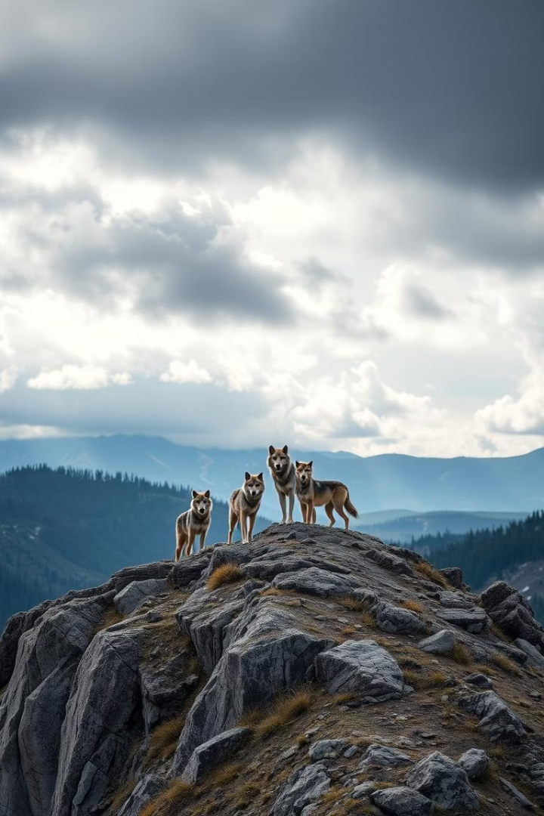
Geofencing Wolf Habitats: Using Convex Hull for Conservation
Welcome. We'll explore a novel approach to protecting wolf habitats using convex hull algorithms. This method allows for dynamic, scalable geofencing.
LAKSHMI SRINIVASAMURTHY
KYLE MANNING
RYAN ISAACSON

Slide 2


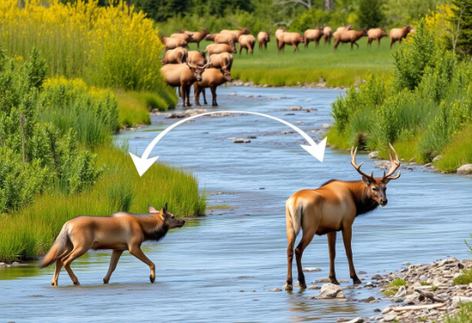
The Problem: Wolf Depletion and Ecosystem Impact
Historical Decline
Reintroduction and Recovery
Ecological Importance
The last wolf pack in Yellowstone was eradicated in 1926. Their absence created an ecosystem imbalance.
In 1995, wolves were reintroduced, restoring balance and promoting biodiversity.
Wolves regulate elk populations, preventing overgrazing and fostering healthy riparian zones. They contribute to the food web by providing carrion for scavengers.

Slide 3
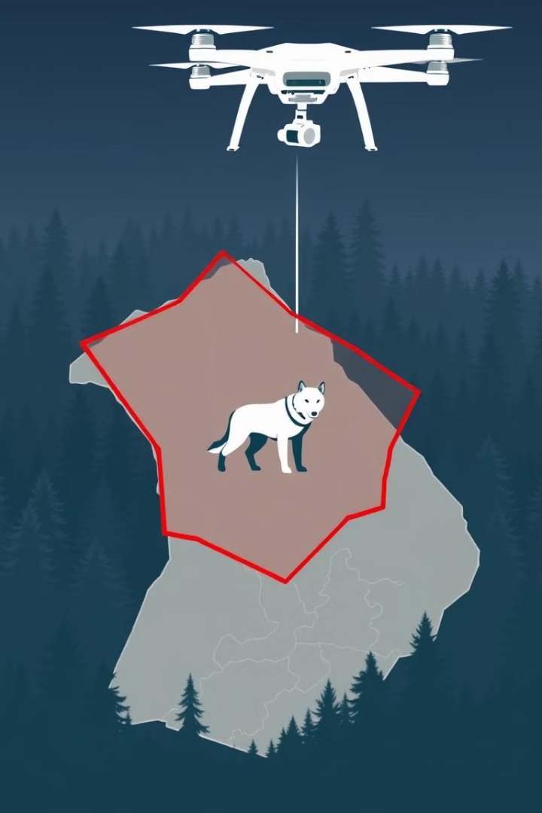
Solution: Geofencing for Wolf Protection
Dynamic Boundaries
Drone Surveillance
Utilizing convex hull algorithms, we can create a dynamic, naturally determined "fence" to protect wolves.
The perimeter can be patrolled by drones, ensuring effective monitoring and enforcement.
Penalties for Violations
Hunters found within or crossing the geofenced area will face strict penalties.

Slide 4

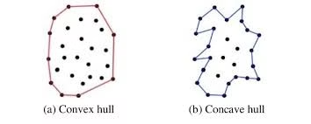
The Convex Hull Monotone Chain Algorithm
1
1. Data Point Collection
Begin by collecting data points representing wolf sighting locations.
2
2. Sorting
Next, sort the points by x-coordinate (then y-coordinate in case of a tie).
3
3. Clockwise Rotation Check and Hull Creation
Finally, the algorithm checks for clockwise rotation using the cross product to identify the smallest convex polygon.

Slide 5
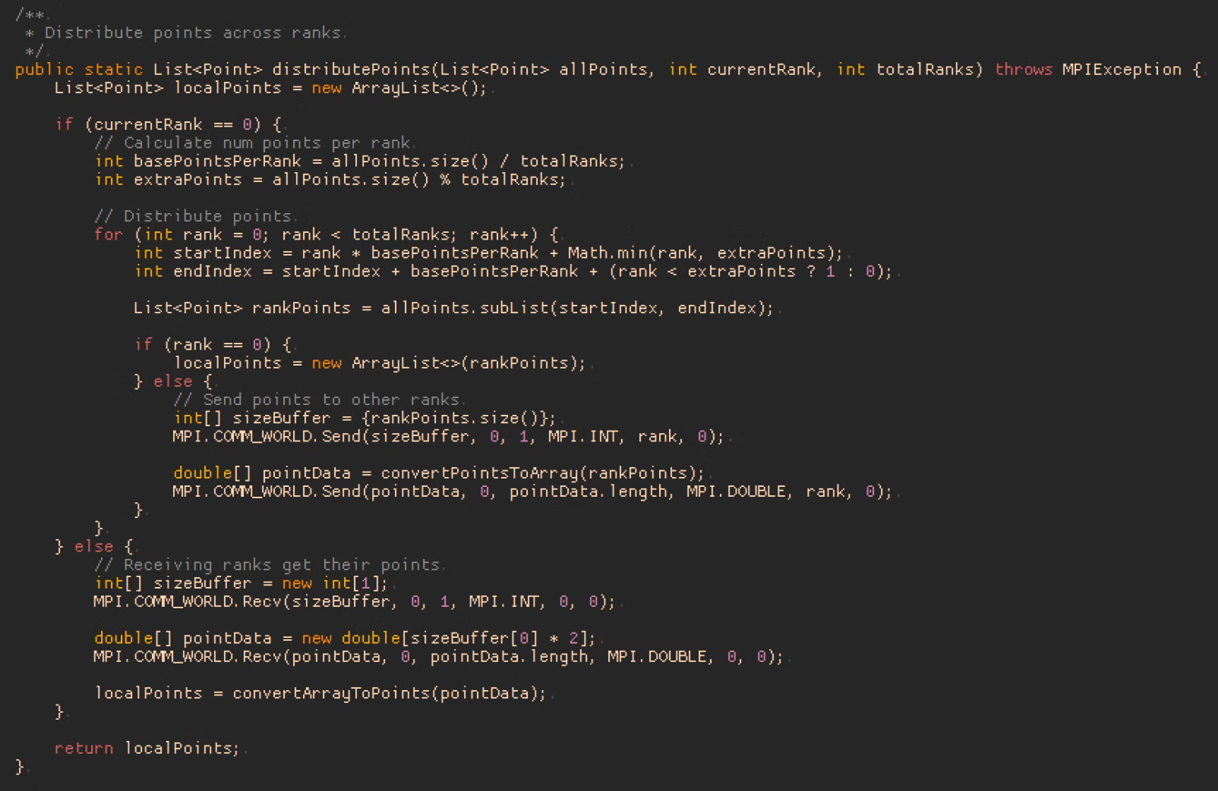
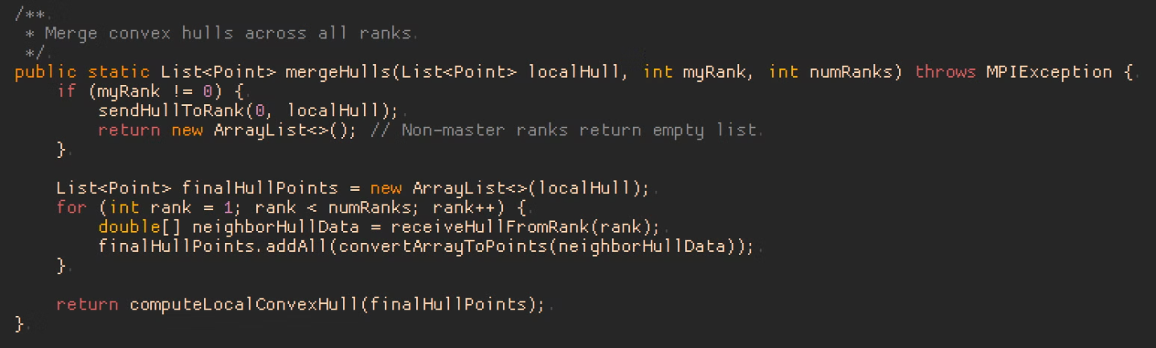
Important Code Snippet: MPI:

Slide 6
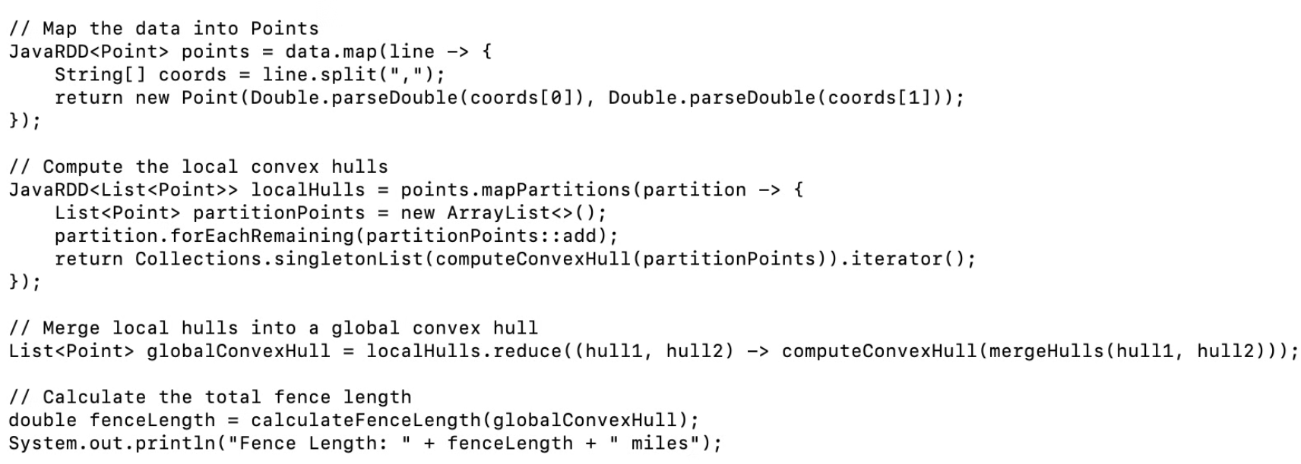
Spark:

Slide 7
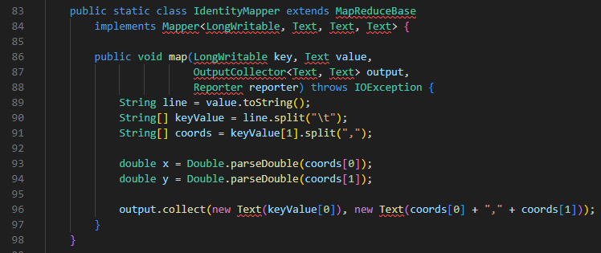
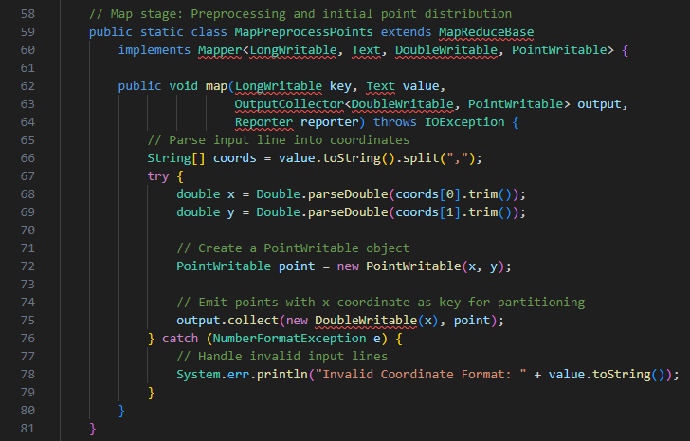
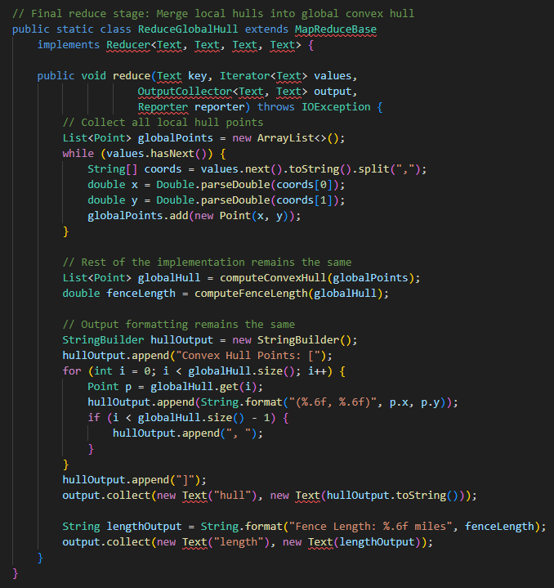
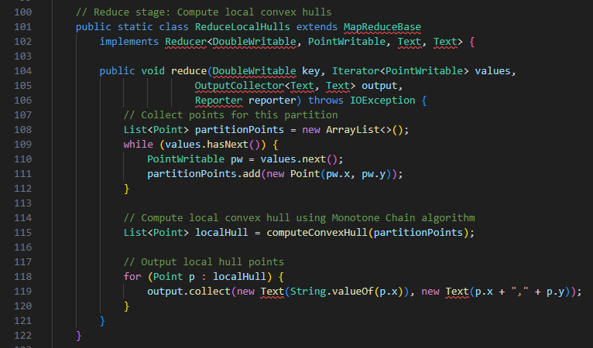
MapReduce:

Slide 8
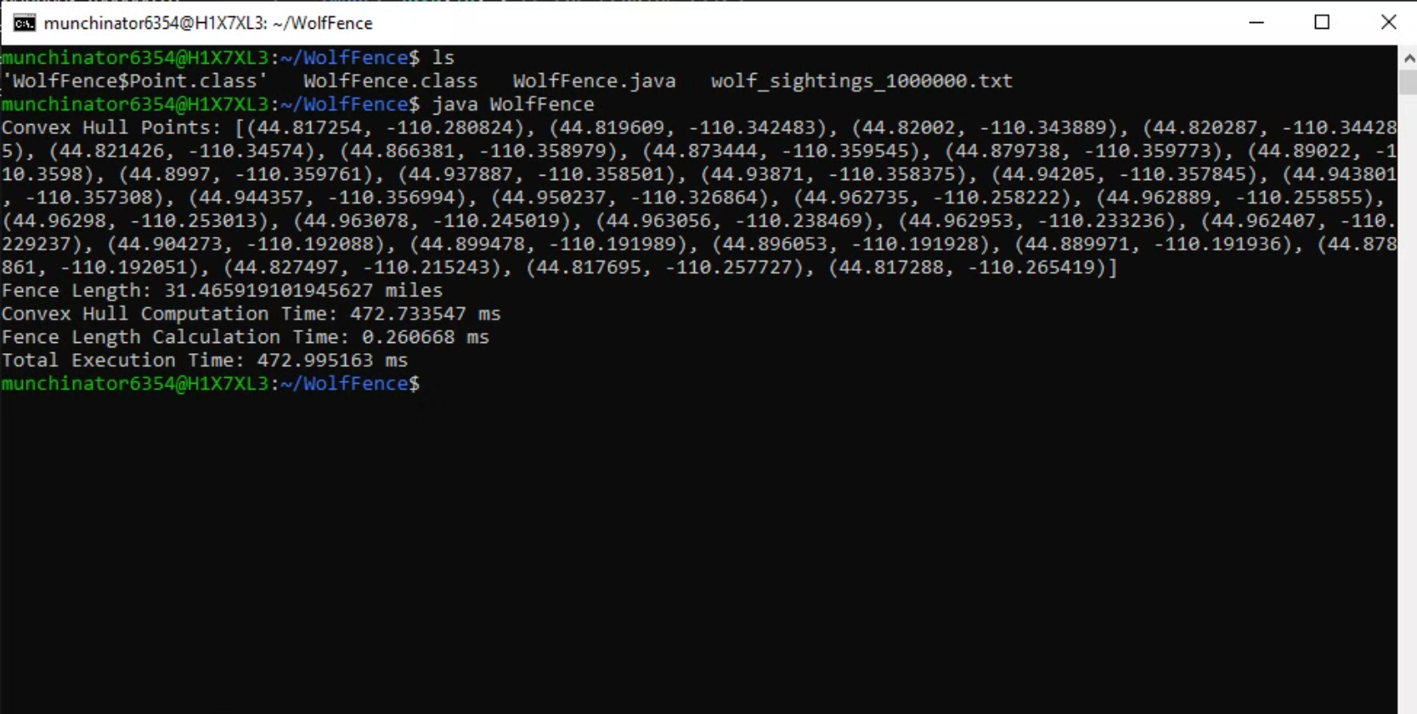
Sequential Solution Demo:

Slide 9
Parallelized Solution Execution
Spark:
MPI:

Slide 10
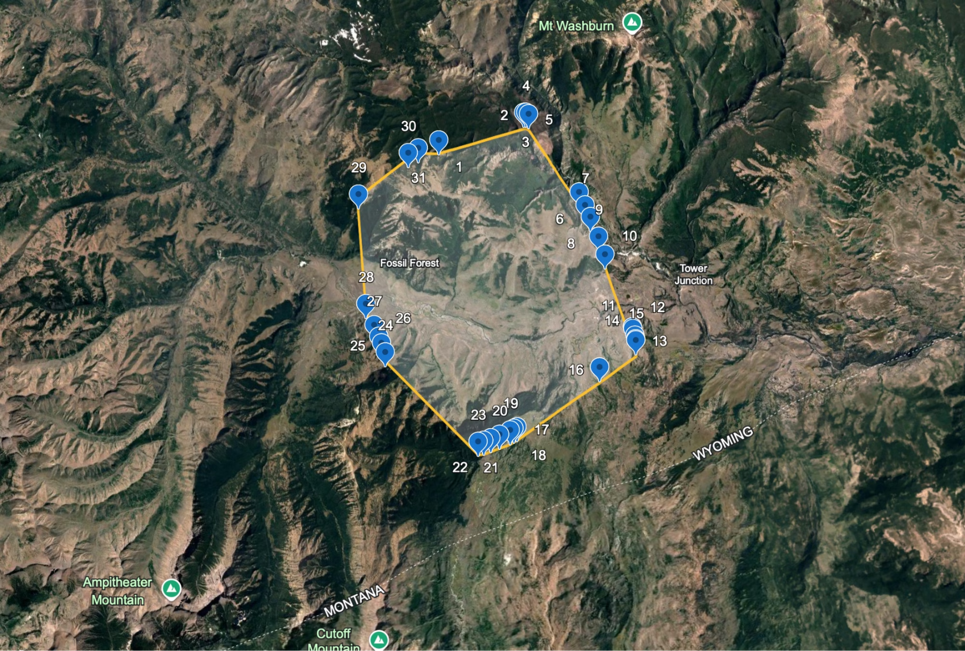
Parallelized Solution Execution

Slide 11
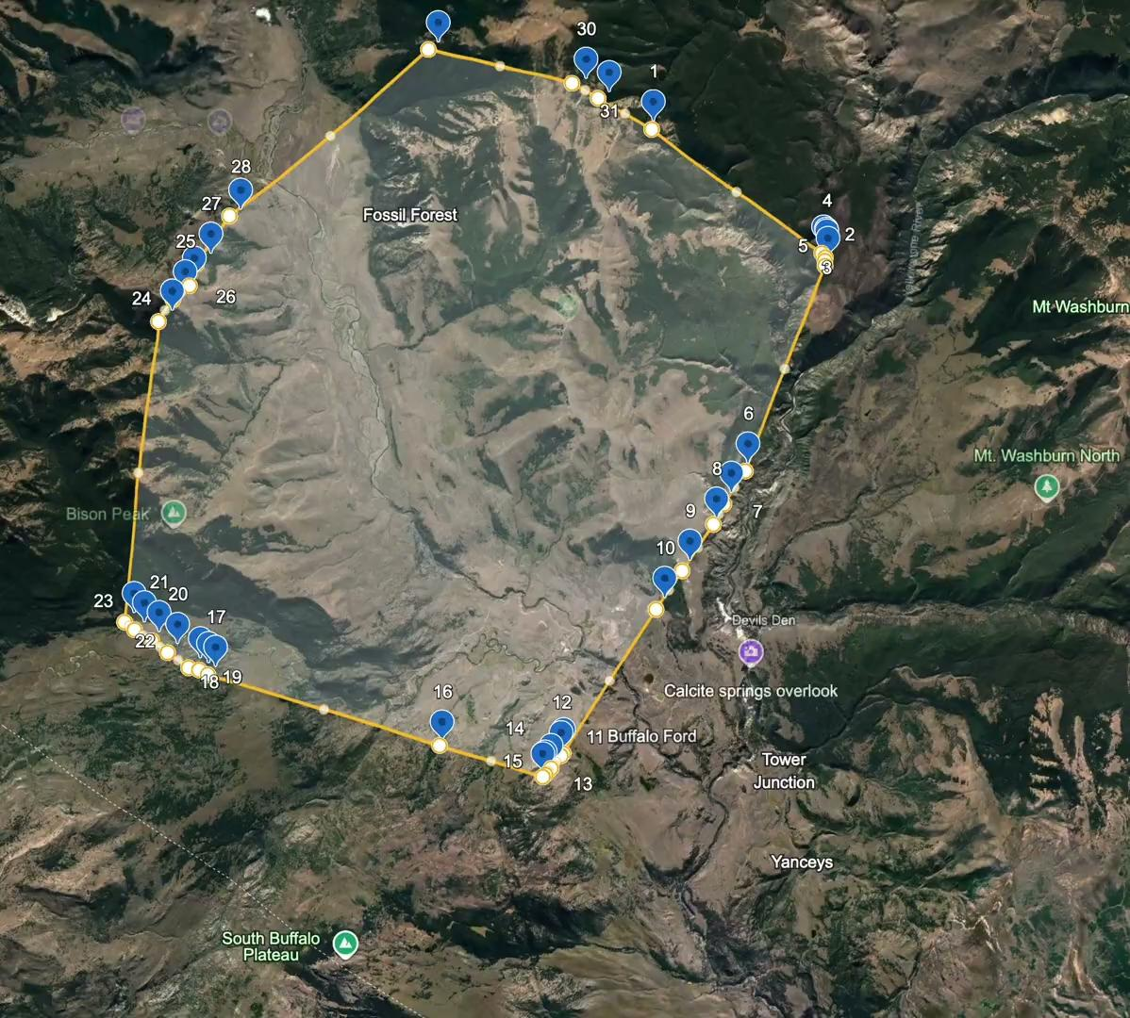

Slide 12
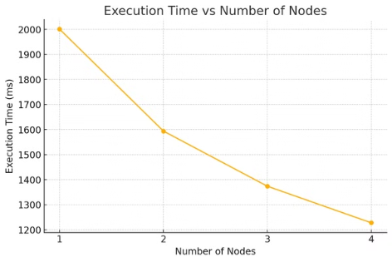
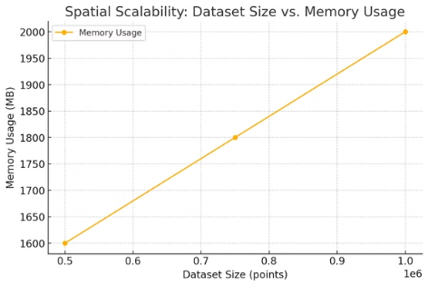
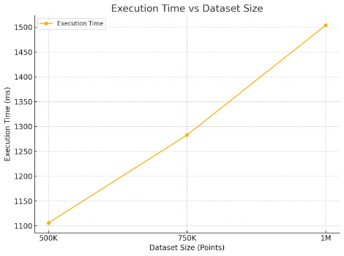
Execution Performance
Spark:
mpiJava:
# Nodes | Exec. Time (ms)
1 | 1002.6
2 | 717.5
3 | 590.9
4 | 531.8

Slide 13
Parallel Processing Strategy: MASS
Places represent a grid of distributed data containers in MASS
Agents are mobile entities in MASS that perform computations or move between Places.
exchangeAll() is a MASS function used for communication between Places. It allows data to be exchanged between neighboring or connected Places.
Partition Data Across MASS Places
1
Use Places to spatially distribute input points across nodes, ensuring each partition corresponds to a unique computational region.
2
Parallel Local Computation with Agents
Deploy Agents to compute local convex hulls within their respective Places, leveraging MASS’s callAll() for parallel execution.
Global Aggregation via exchangeAll()
3
Utilize MASS’s inter-place communication, exchangeAll(), to share local hull results between Places and aggregate them into a final global convex hull.

Slide 14
Programmability Considerations
LoC
mpiJava: Low-level communication → high LoC count
Map Reduce - ~275
Spark: Spark reduces LOC with concise APIs for distributed tasks. ~125
Boilerplate Percentage
mpiJava: High amount of boilerplate (ex: MPI.COMM_WORLD.Send(), MPI.COMM_WORLD.Recv())
Spark: Spark has Minimal boilerplate thanks to built-in job scheduling and partitioning
MapReduce ~63% boilerplate code
Cyclomatic Complexity
mpiJava: High due to rank-specific sections and looping through ranks
Spark: Low complexity due to modular functions and pre-built transformations.
MapReduce: Current cyclomatic complexity of 9
Lack of Cohesion in Methods
Spark: High cohesion as Spark methods are task-specific and reusable.
MapReduce: Higher LCOM due to functional separation between jobs rather than a shared state

Slide 15
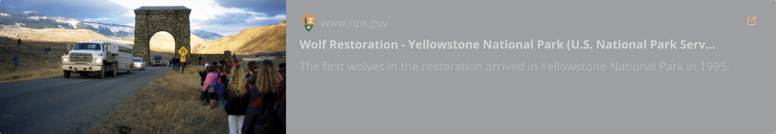
Restoration Information

